Slide 1
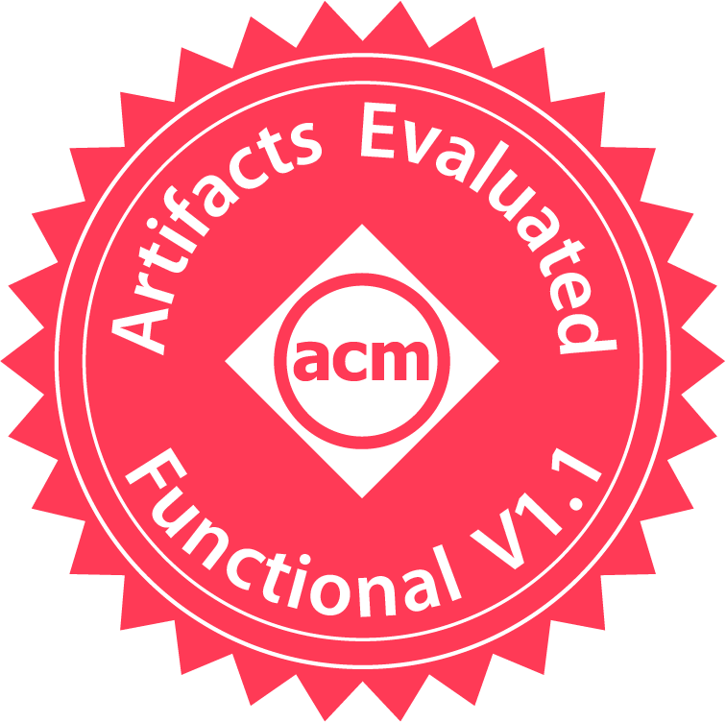

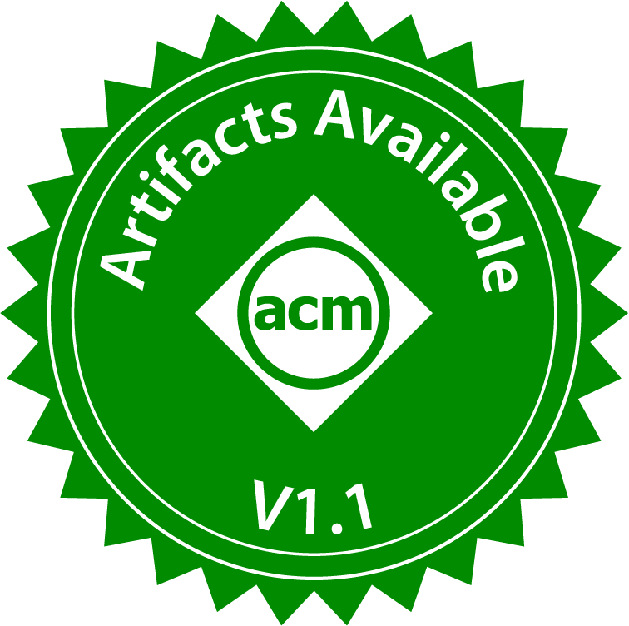

Mobile Foundation Model as Firmware The Way Towards a Unified Mobile AI Landscape
The 30th Annual International Conference On Mobile Computing And Networking (MobiCom 2024)
Jinliang Yuan*, Chen Yang*, Dongqi Cai*
Shihe Wang, Xin Yuan, Zeling Zhang, Xiang Li, Dingge Zhang, Hanzi Mei, Xianqing Jia
Shangguang Wang, Mengwei Xu
Beijing University of Posts and Telecommunications
Presenter: Hao Wen (Tsinghua University)
Notes:
Good morning/afternoon, everyone.
I am Hao Wen from Tsinghua University.
Today, I will help with presenting an interesting work about foundation model for mobile devices.
It is done by a research group of BUPT. Unfortunately, those authors cannot attend the conference due to visa issue.
Now let’s get started.

Slide 2









Motivation: Mobile AI Fragmentation
APPs
Diversified on-device DNN types, parameters, and configurations
Input word prediction; QA; ASR; SLU; Image classification;
Machine translation; Object detection; Style transfer; TTS; Audio captioning; Image captioning; Visual QA; ……
MobileNet; ResNet; Bert; StyleFlow; RoBERTa; DistilBERT; Deeplabv3plus; GFNet; MSINet; LIMU-BERT; YOLO; ……
Operating System
Hardware
Notes:
Mobile AI is a fast-growing and exciting topic where we’ve seen a bunch of research efforts to improve the runtime efficiency.
One fundamental challenge we identify is the fragmentation of mobile AI models, that is the model architectures, parameters, or configurations are diversified. For example, we have convolutional and recurrent neural network; within the category of convolutional neural networks, there are different convolution types or hyper-parameters.
Such fragmentation brings at least three levels of issues.

Slide 3
Motivation: Mobile AI Fragmentation
APPs
Diversified on-device DNN types, parameters, and configurations
H/W accelerator design trades off efficiency for generality
Input word prediction; QA; ASR; SLU; Image classification;
Machine translation; Object detection; Style transfer; TTS; Audio captioning; Image captioning; Visual QA; ……
MobileNet; ResNet; Bert; StyleFlow; RoBERTa; DistilBERT; Deeplabv3plus; GFNet; MSINet; LIMU-BERT; YOLO; ……
Operating System
Hardware
Notes:
First, hardware accelerator design such as NPU has to tradeoff efficiency for generality to support different types of models.

Slide 4
Motivation: Mobile AI Fragmentation
APPs
Diversified on-device DNN types, parameters, and configurations
H/W accelerator design trades off efficiency for generality
S/W optimizations becomes ad-hoc
Input word prediction; QA; ASR; SLU; Image classification;
Machine translation; Object detection; Style transfer; TTS; Audio captioning; Image captioning; Visual QA; ……
MobileNet; ResNet; Bert; StyleFlow; RoBERTa; DistilBERT; Deeplabv3plus; GFNet; MSINet; LIMU-BERT; YOLO; ……
Operating System
Hardware
Notes:
Second, the software optimization becomes ad-hoc as they are often model-specific.

Slide 5
Motivation: Mobile AI Fragmentation
APPs
Diversified on-device DNN types, parameters, and configurations
H/W accelerator design trades off efficiency for generality
S/W optimizations becomes ad-hoc
OS-agnostic, so no opportunity for caching/scheduling/batching
Input word prediction; QA; ASR; SLU; Image classification;
Machine translation; Object detection; Style transfer; TTS; Audio captioning; Image captioning; Visual QA; ……
MobileNet; ResNet; Bert; StyleFlow; RoBERTa; DistilBERT; Deeplabv3plus; GFNet; MSINet; LIMU-BERT; YOLO; ……
Operating System
Hardware
Notes:
Third, the models are owned by each app, so operating system does not have a global view or control for cross-app AI tasks scheduling or cache reuse.
All these challenges are fundamental and have not been elegantly addressed in prior work.

Slide 6

A Vision: Mobile Foundation Model
APPs
APPs
Input word prediction; QA; ASR; SLU; Image classification;
Machine translation; Object detection; Style transfer; TTS; Audio captioning; Image captioning; Visual QA; ……
Input word prediction; QA; ASR; SLU; Image classification;
Machine translation; Object detection; Style transfer; TTS; Audio captioning; Image captioning; Visual QA; ……
MobileNet; ResNet; Bert; StyleFlow; RoBERTa; DistilBERT; Deeplabv3plus; GFNet; MSINet; LIMU-BERT; YOLO; ……
MobileNet; ResNet; Bert; StyleFlow; RoBERTa; DistilBERT; Deeplabv3plus; GFNet; MSINet; LIMU-BERT; YOLO; ……
A One-size-fits-all Model
Operating System
Operating System
Hardware
Hardware
Notes:
So, we wonder, can we have a one-size-fits-all model that can handle every mobile AI task, so such fragmentation can be completely eliminated?
If possible, such a foundation model has a chance to totally shift the paradigm of mobile AI ecosystem as we can imagine.

Slide 7
A Vision: Mobile Foundation Model
APPs
APPs
Input word prediction; QA; ASR; SLU; Image classification;
Machine translation; Object detection; Style transfer; TTS; Audio captioning; Image captioning; Visual QA; ……
Input word prediction; QA; ASR; SLU; Image classification;
Machine translation; Object detection; Style transfer; TTS; Audio captioning; Image captioning; Visual QA; ……
MobileNet; ResNet; Bert; StyleFlow; RoBERTa; DistilBERT; Deeplabv3plus; GFNet; MSINet; LIMU-BERT; YOLO; ……
MobileNet; ResNet; Bert; StyleFlow; RoBERTa; DistilBERT; Deeplabv3plus; GFNet; MSINet; LIMU-BERT; YOLO; ……
Foundation Model
A Firmware
Operating System
Operating System
Runtime
Hardware
Hardware
NPU
Notes:
Taking a step further, the foundation model will be served on a highly-optimized software runtime as well as a dedicated hardware accelerator, making the full-stack AI capability a firmware that comes with the device vendor. In such a way, the algorithm, software, and hardware will be extremely co-designed for the best runtime efficiency.

Slide 8
Our Contributions
How to design such a model?
How to evaluate such a model?
APPs
M4 – an any-to-any modality mobile foundation model
Input word prediction; QA; ASR; SLU; Image classification;
Machine translation; Object detection; Style transfer; TTS; Audio captioning; Image captioning; Visual QA; ……
MobileNet; ResNet; Bert; StyleFlow; RoBERTa; DistilBERT; Deeplabv3plus; GFNet; MSINet; LIMU-BERT; YOLO; ……
A One-size-fits-all Model
Operating System
eAIBench – a comprehensive mobile AI benchmark
Hardware
Notes:
The questions this paper aims to answer are simple.
First, can we design such a one-size-fits-all foundation model that can address every mobile AI task?
Second, how can we evaluate the effectiveness of the model we proposed, given that there is no such comprehensive, cross-modality mobile AI benchmark.
In response, we present M4, the first any-to-any modality mobile foundation model and eAIBench, a comprehensive AI benchmark for evaluating such foundation model.

Slide 9



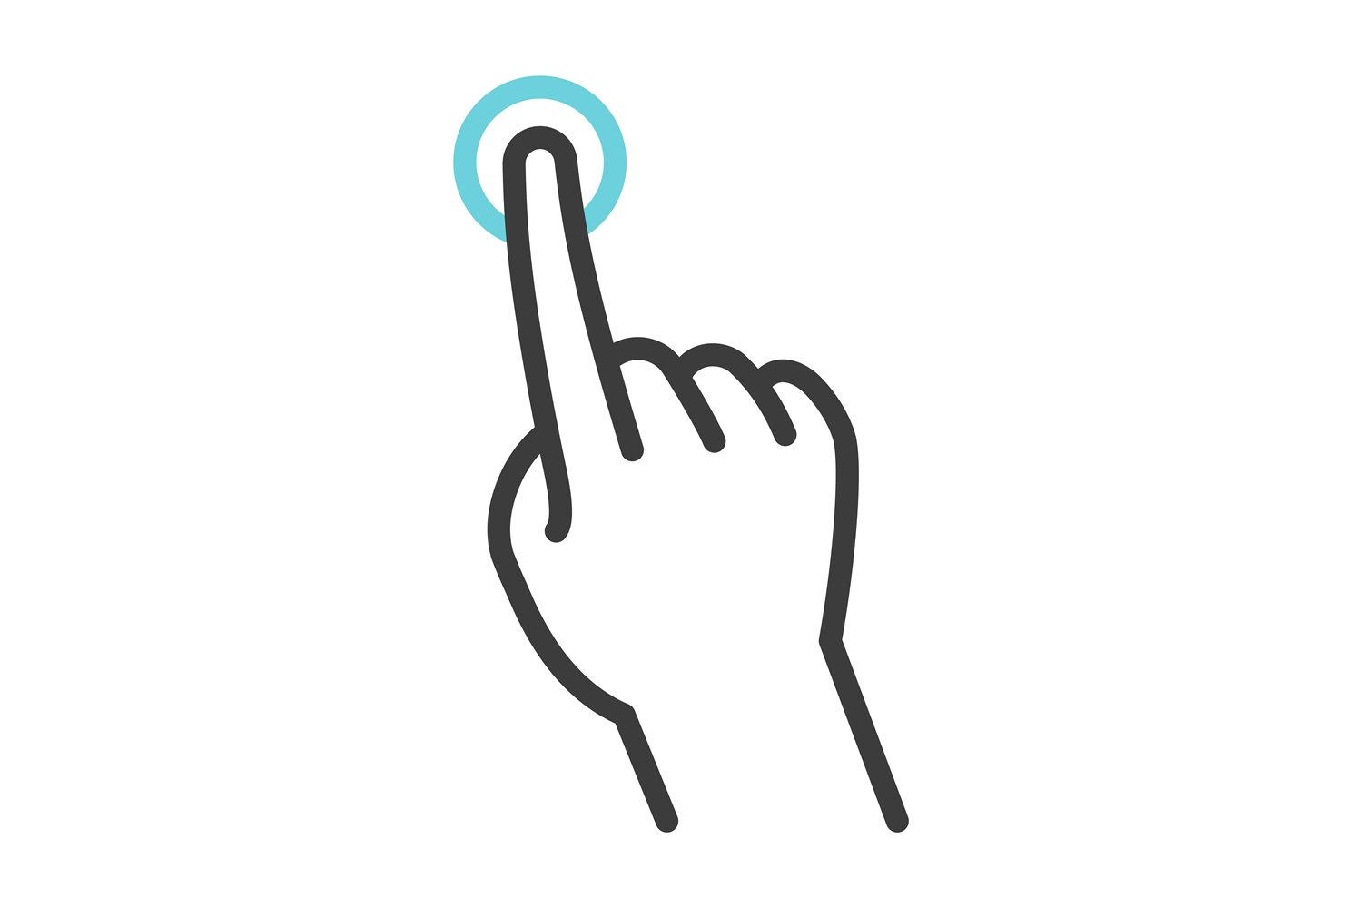

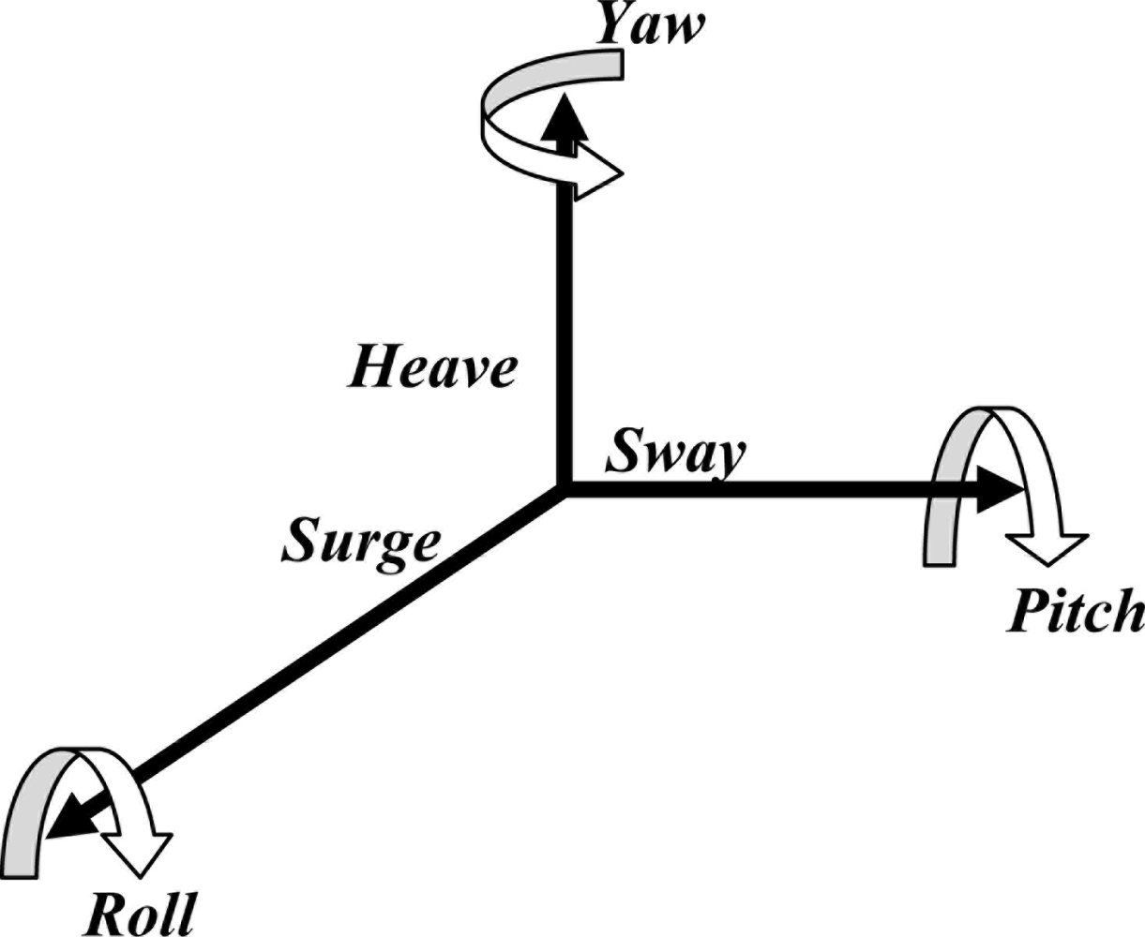


M4 Design
unified latent space
IMG-Enc
1.4
-0.2
-2.3
0.6
9.1
…
TXT-Enc
IMU-Enc
AUD-Enc
Multimodal Embedding
Notes:
The design of M4 is intuitive. It first uses a set of transformer encoders to process different modalities of data, and embed them into the same unified latent space.

Slide 10
M4 Design
unified latent space
IMG-Enc
1.4
-0.2
-2.3
0.6
9.1
…
TXT-Enc
Projector
IMU-Enc
Pretrained
LLM Backbone
(LLaMA, Vicuna, etc)
AUD-Enc
Multimodal Embedding
Understanding & Reasoning
Notes:
We then feed it into a pre-trained large language model for perform complex understanding and reasoning logics.

Slide 11
M4 Design
unified latent space
Object detection
Image retrieval
Super-resolution
Style transfer
OCR
Vehicle ReID
Crowd counting
Q&A
Word prediction
Doc. summary
ASR
SLU
HAR
TTS
VQA
Image captioning
…
(more in Table 3)
IMG-Enc
1.4
-0.2
-2.3
0.6
9.1
…
IMG-Dec
TXT-Enc
Projector
TTS-Dec
IMU-Enc
Pretrained
LLM Backbone
(LLaMA, Vicuna, etc)
CLS-Dec
AUD-Enc
Multimodal Embedding
Multimodal Generator
Understanding & Reasoning
Notes:
Finally, the output of the pre-trained LLM goes to different transformer decoders to generate data in different modalities, for example, diffusion for image generation and a simple MLP layer for classification task.

Slide 12
M4 Implementation
unified latent space
IMG-Enc
1.4
-0.2
-2.3
0.6
9.1
…
IMG-Dec
Trained from scratch
TXT-Enc
Projector
TTS-Dec
Total params:
~8.5B
Trainable params:
5M-33M
IMU-Enc
Pretrained
LLM Backbone
(LLaMA, Vicuna, etc)
Finetuned using LoRa
CLS-Dec
AUD-Enc
Freezed
Multimodal Embedding
Multimodal Generator
Understanding & Reasoning
Notes:
M4 contains three trainable parts to adapt to downstream mobile AI tasks: two LoRa modules which are inserted to relevant encoder and the foundation backbone separately; and one MLP projector.
Overall, the model has 8.5B parameters, but only a very small portion of them needs to be adjusted for each task.

Slide 13
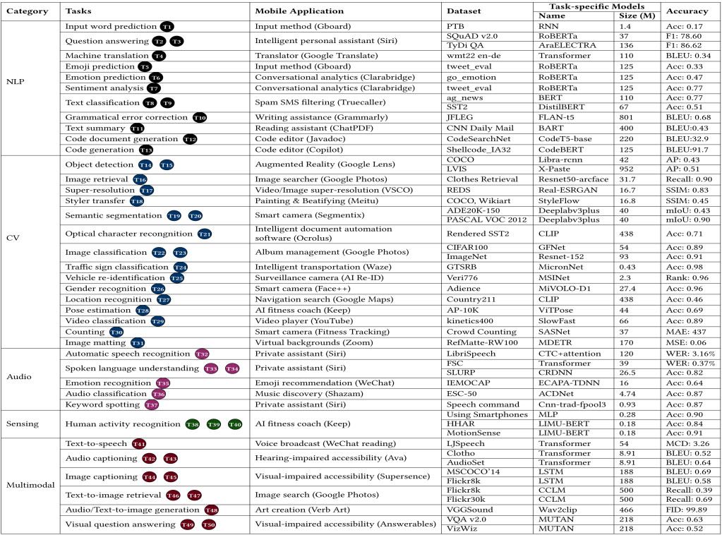
Evaluation: eAIBench
eAIBench: a collection of real-world mobile AI tasks and a representative baseline DNN
38 mobile AI tasks
50 classical ML datasets
4 modalities (text, image, audio, IMU)
Many hardware setups: Octa-core CPU, Mali-G710 MP7 GPU, and edge TPU, etc.
eAIBench
Notes:
To evaluate M4, we built a comprehensive benchmark that includes 38 diverse tasks, 50 classical datasets spanning four popular modalities. For each task, we also develop one representative baseline model before the LLM era as comparison.

Slide 14
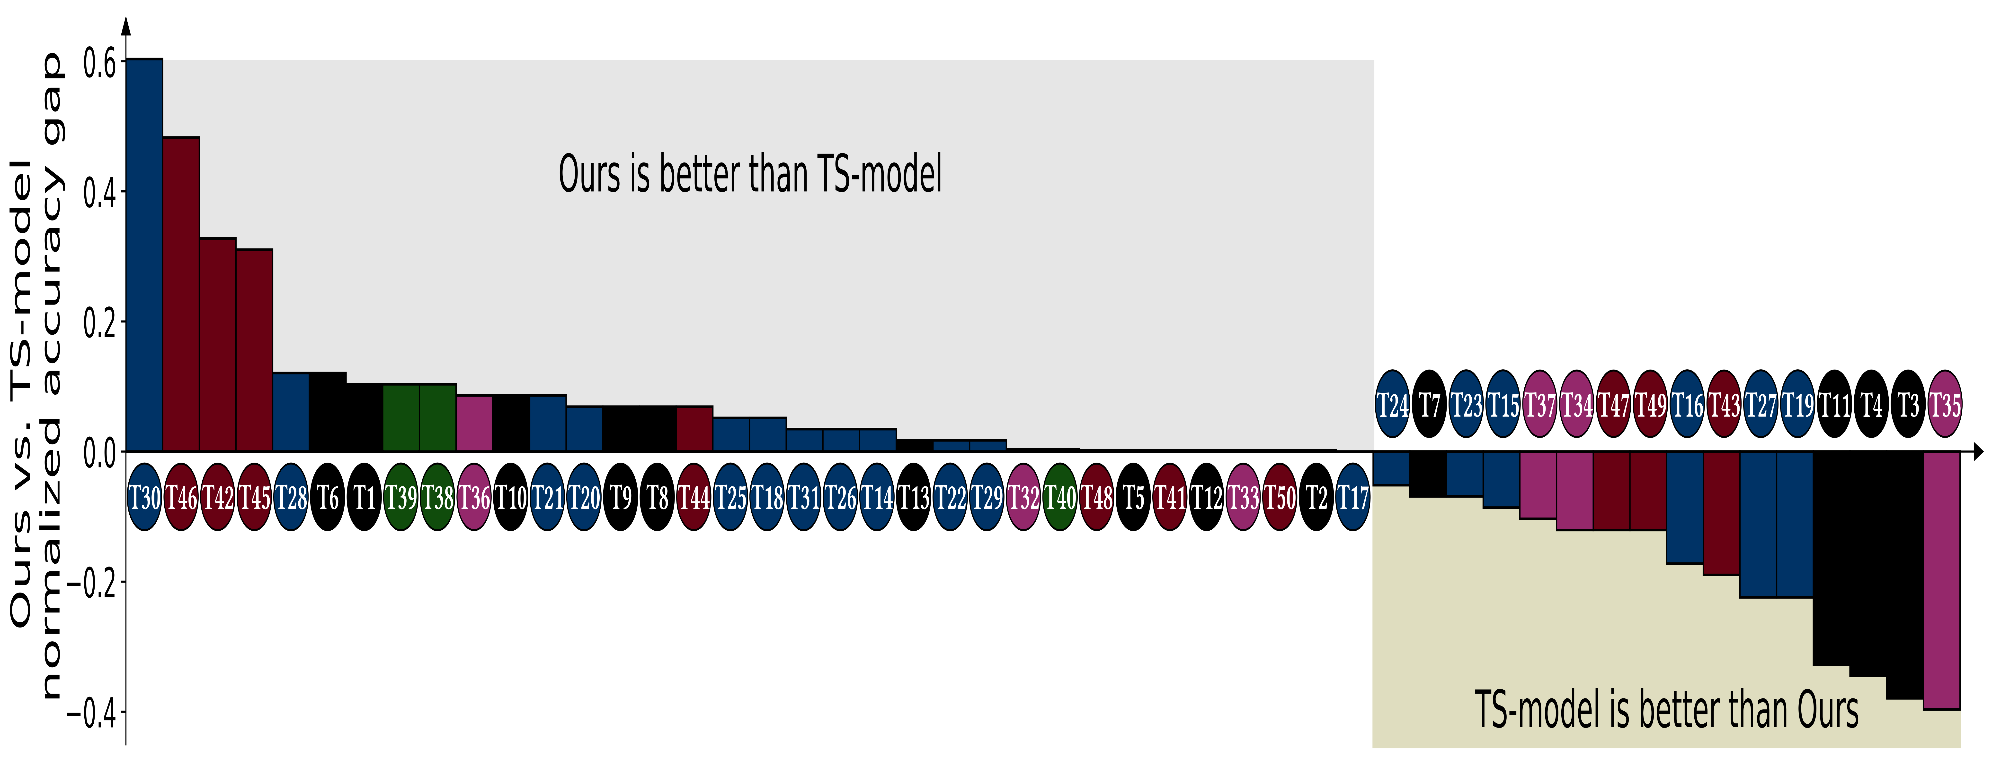
Evaluation: End-to-end Performance
M4 can well support most mobile AI tasks and datasets.
M4 outperforms baseline models
Figure 1. Normalized accuracy comparison of M4 and TS-models on 50 popular mobile tasks and datasets.
M4 can achieve comparable performance across 85% of tasks, with over 50% of these tasks showcasing considerable performance improvement.
Notes:
The key result shows that, across 85% tasks, M4 can match the performance of those baseline models tailored for each task, and over half of these tasks even see significant performance gains. Only in a few tasks like translation we find M4 to be inferior than baseline models due to the limited capability of the backbone LLM we used.

Slide 15
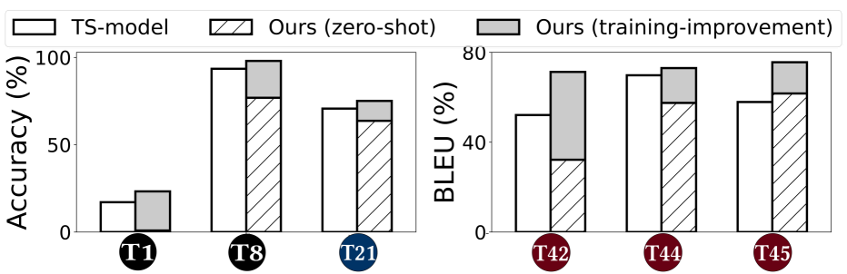
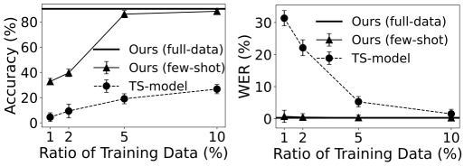
Evaluation: Zero/Few-shot Ability
M4 also has a certain zero-shot ability, but fine-tuning makes it much more accurate.
M4 has better few-shot ability than TS-models that are trained from scratch.
Notes:
We also tested M4’s zero-shot capabilities. While it performs well without fine-tuning, we found that even minimal tuning significantly boosts its accuracy, making it highly adaptable to new tasks.

Slide 16
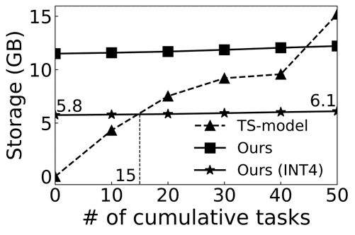
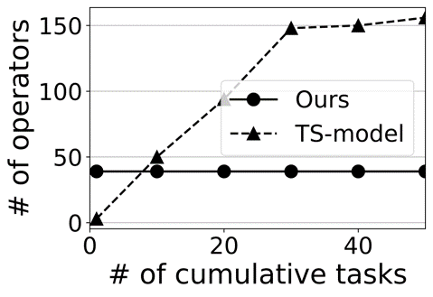
Evaluation: Runtime Cost
M4 is more storage-efficient when the model number scales out.
M4 greatly simplify accelerator design.
Notes:
Regarding the resource efficiency, storage efficiency is another strength of M4. As the number of supported tasks scales, M4 remains lightweight compared to deploying multiple task-specific models. Moreover, with proper optimization for NPUs, its execution speed and energy consumption can match those of traditional models.

Slide 17


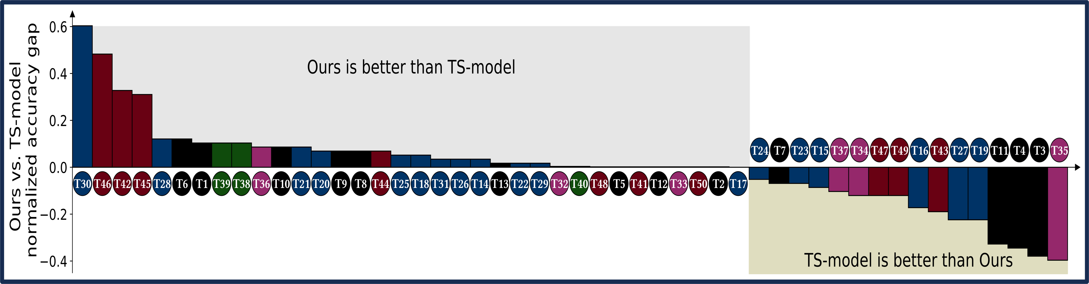


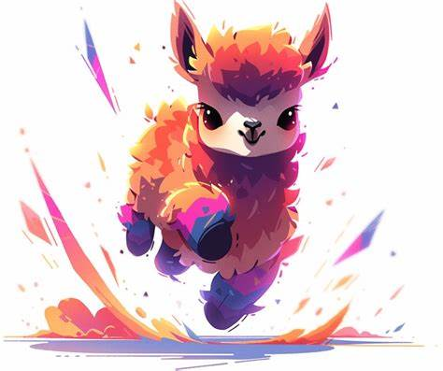
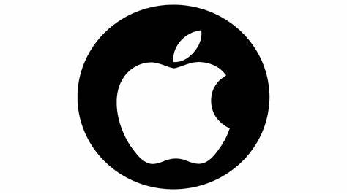
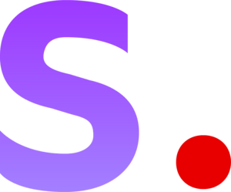
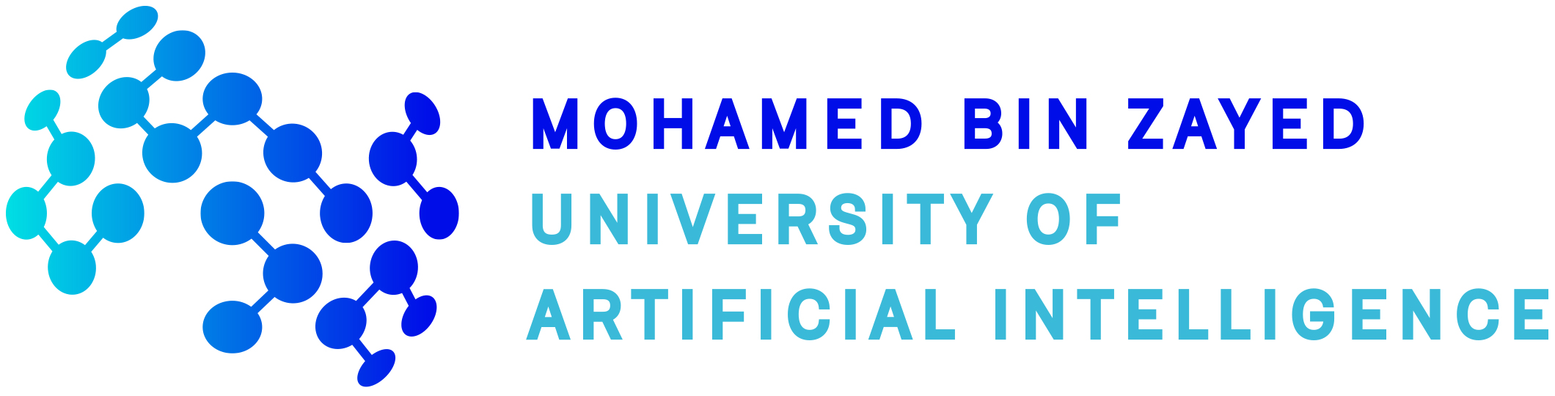

M4 evolves with better backbones
Beat over 50% of TS-model
Default
Backbone
2023.07
LLaMA 1
LLaMA 2
2023.02
M4 can be further enhanced with enhanced foundation models.
Notes:
The last part is about the future of mobile foundation model. As shown in the figure
M4 continues to improve with advancements in its backbone models.(click) For instance, the transition from LLaMA1 to LLaMA2 resulted in up to a 15% accuracy improvement. This demonstrates its potential for sustained growth and improvement over time because we are having more and more stronger backbones to use.

Slide 18

M4 evolves with better backbones
Beat over 50% of TS-model
Default
Backbone
2023.07
Up to 15%
accuracy improvement
LLaMA 1
LLaMA 2
2023.02
M4 can be further enhanced with enhanced foundation models.
Notes:
The last part is about the future of mobile foundation model. As shown in the figure
M4 continues to improve with advancements in its backbone models.(click) For instance, the transition from LLaMA1 to LLaMA2 resulted in up to a 15% accuracy improvement.(click) This demonstrates its potential for sustained growth and improvement over time because we are having more and more stronger backbones to use.

Slide 19
M4 evolves with better backbones
Beat over 50% of TS-model
Default
Backbone
2023.07
Up to 15%
accuracy improvement
LLaMA 1
LLaMA 2
More LLM backbones
now available!
2023.02
M4 can be further enhanced with enhanced foundation models.
Notes:
The last part is about the future of mobile foundation model. As shown in the figure
M4 continues to improve with advancements in its backbone models.(click) For instance, the transition from LLaMA1 to LLaMA2 resulted in up to a 15% accuracy improvement.(click) This demonstrates its potential for sustained growth and improvement over time because we are having more and more stronger backbones to use.

Slide 20
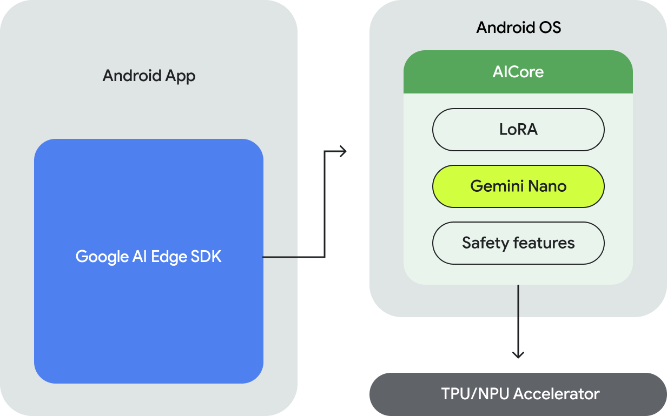
No longer a vision now!
Google has turned our vision into reality on Android!
Gemini Nano as a standalone system service
Apps access the LLM through prompts or LoRa
On-device LLM directly accelerated by TPU/NPU
[1] https://developer.android.com/ai/gemini-nano
Notes:
Also, we are glad to see that after this work accepted, Google has taken the very first step to integrate its large language model into the Android OS, as called AICore service. It is supporting the language generation capability of many Google Apps and third-party apps. So, a mobile foundation model is no longer a vision but reality.

Slide 21
Summary of our contribution
Mobile Foundation Model as Firmware
Jinliang Yuan*, Chen Yang*, Dongqi Cai*,..., Shangguang Wang, Mengwei Xu
Contact: mwx@bupt.edu.cn
A vision of having one foundation model to replace all fragmented DNNs on mobile devices.
A design and prototype of such a foundation model.
A comprehensive benchmark that demonstrates its feasibility.
Takeaway: time to revolutionize mobile AI landscape!
Code: https://github.com/UbiquitousLearning/MobileFM
Notes:
To wrap up, this work proposes a vision of having one foundation model to replace all fragmented DNNs on mobile devices. It also provides a prototype of such foundation model and demonstrates its feasibility with experiments. The code and weights are all open-sourced.
Thank you for your time, and I’m happy to take questions!

